Slide 1


Analysing CRISPR screens with MAGeCK and edgeR
Workshop
Dr Göknur Giner
Senior Postdoctoral Researcher at
Walter and Eliza Hall Institute of Medical Research
&
Olivia Newton Johns Cancer Research Institute
https://github.com/goknurginer
https://twitter.com/goknurginer
Notes:
Welcome to the Analysing CRISPR screens with MAGeCK and edgeR, today I will discuss my perspective on the latest modalities of CRISPR/Cas gene editing systems. I will focus particularly on DNA editing.

Slide 2



Outline
Part I: Mechanisms of CRISPR/Cas-based systems
Part II: Developing a CRISPR/Cas screen
Workflow for designing and executing CRISPR screens
Workflow for analyzing NGS data from CRISPR screens
Part III: Example CRISPR analysis with edgeR and MAGeCK
Notes:
My talk consists of 4 parts. In the first part I will briefly describe the existing CRISPR/Cas-based systems. In the second part of my talk, I will focus on developing a CRISPR system and in the third part I will highlight some of the computational challenges we face. Then I will introduce you the base editors and our on-going work on designing guides for those editors.

Slide 3
Outline
Part I: Mechanisms of CRISPR/Cas-based systems
Part II: Developing a CRISPR/Cas screen
Workflow for designing and executing CRISPR screens
Workflow for analyzing NGS data from CRISPR screens
Part III: Example CRISPR analysis with edgeR and MAGeCK
Notes:
My talk consists of 4 parts. In the first part I will briefly describe the existing CRISPR/Cas-based systems. In the second part of my talk, I will focus on developing a CRISPR system and in the third part I will highlight some of the computational challenges we face. Then I will introduce you the base editors and our on-going work on designing guides for those editors.

Slide 4
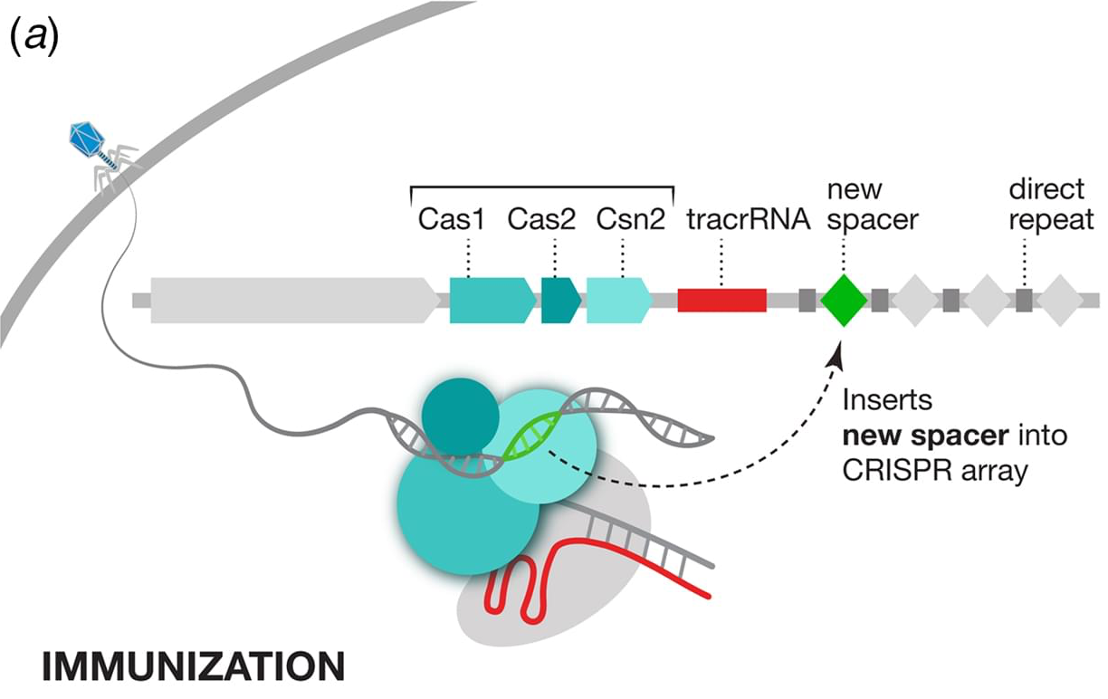
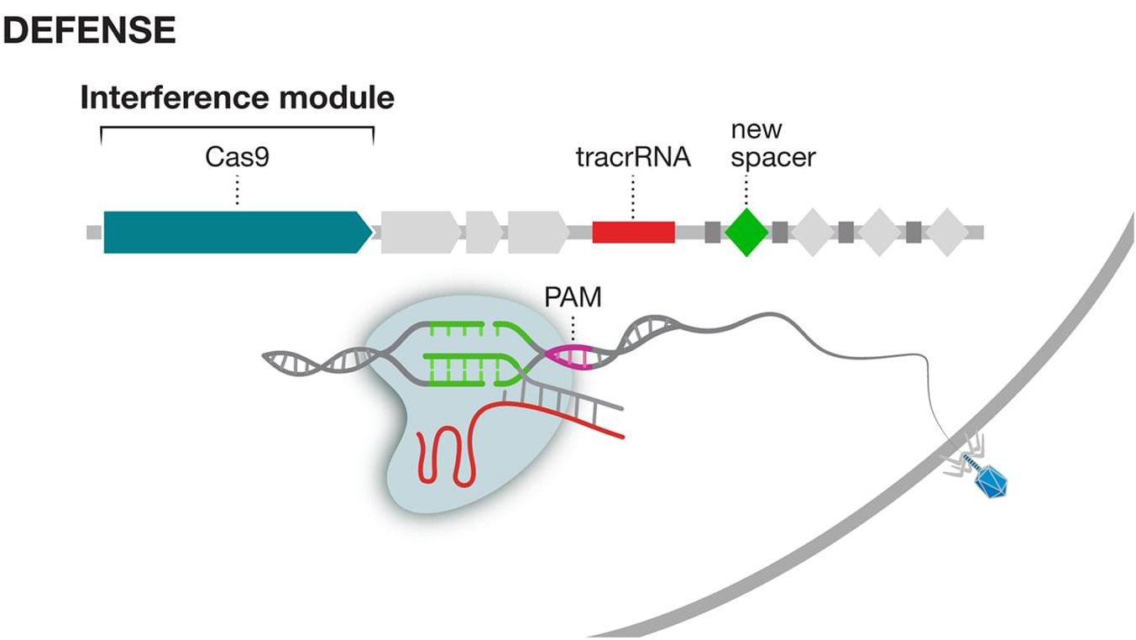
Clustered Regularly Interspaced Short Palindromic Repeats (CRISPR)/CRISPR-Associated (Cas) System
CRISPR/Cas system is a naturally occurring genome editing tool initially described in bacteria as an adaptive immune system.
The protospacer adjacent motif (or PAM for short) is a short DNA sequence (usually 2-6 base pairs in length) that follows the targeted spacer.
Zhang F (2019) – Q Rev Biophys
Notes:
which helps bacteria defend against phages (faacıs) and other foreign genetic materials.
During the immunization phase on the left, an adaptation module, cas nucleases inserts a new spacer, a stretch of DNA derived from the genome of the invader, into the CRISPR array.
CRISPR array consists of repeats and spacers that are genetic codes stored in bacteria’s DNA from past infections.
During the defence phase on the right, spacers are converted into guide RNAs that direct an interference module to matching target sequences, which are then cleaved to destroy the viral DNA.
PAM is the reason that the viral genome fragment embedded in the bacterial genome does not trigger the Cas9 to cut the bacteria's own genome. phage (feyc)
phages (faacıs)
Cas complex checks all the PAM regions in the virus DNA to see if the adjacent sequence match the previously stored viral DNA piece.

Slide 5
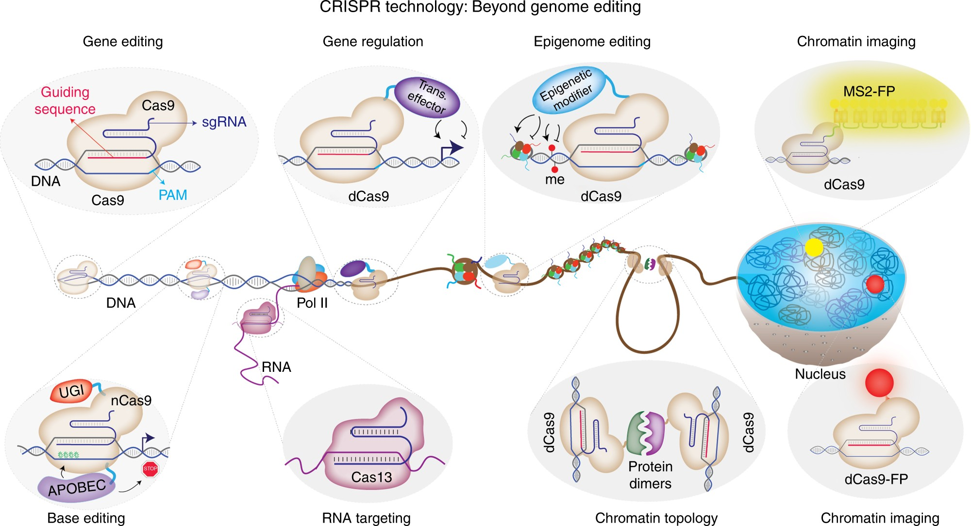
CRISPR technology: Beyond genome editing
Adli 2018
Notes:
CRISPR technology is advancing rapidly and now lets us explore some of these more complex scenarios
For example, we can now use CRISPR to activate/inhibit genes, edit the epigenome, and even target RNA.
Marco Herold’s lab has been developing many of these technologies here at WEHI in cell lines and animal models.
They have started a project last year using base editing technology to find mutations in MCL-1 gene which could make lymphomas resistant to MCL-1 inhibitors
Several members of Marco’s lab are exploring the use of CRISPR for gene regulation.

Slide 6
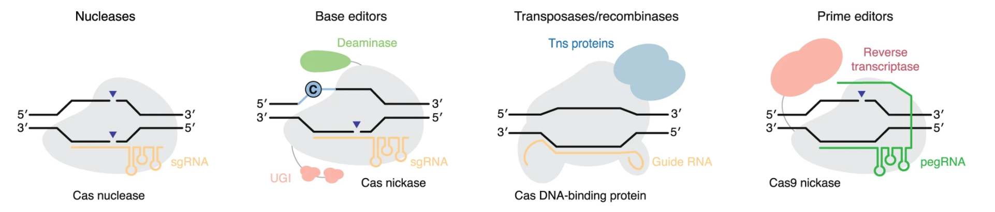
Existing CRISPR modalities targeting DNA alterations
Wild-type Cas nucleases
Base editors
Transposases/recombinases
Prime editors
Anzalone et al. (2020) – Nat Biotechnol.
Notes:
The existing CRISPR systems can be categorized into four classes. Nucleases, base editors, transposases/recombinases and prime editors.

Slide 7
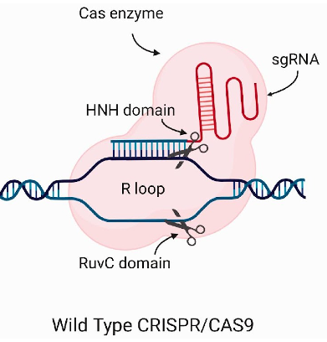
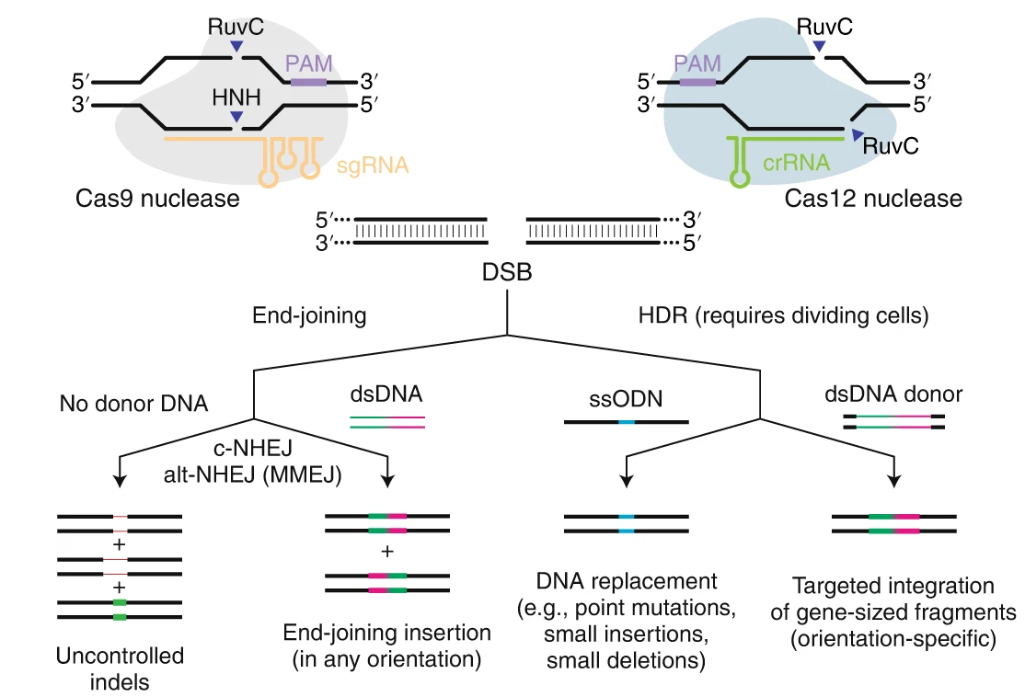
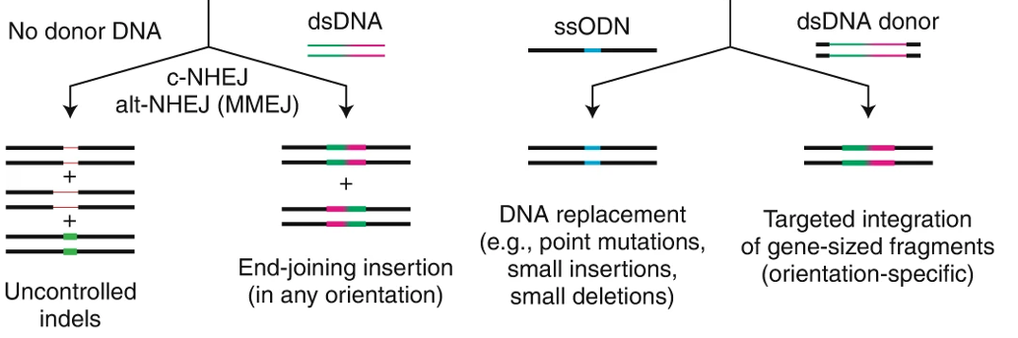
1) Genome editing with wild-type CRISPR/Cas9 nucleases
To edit the DNA, Cas nucleases form double-stranded DNA breaks (DSBs)
Non-homologous end joining (NHEJ)
Homology-directed repair (HDR)
CRISPR Knockouts
CRISPR Knock-ins
Caso and Davies (2021) – Lab Anim.
Anzalone et al. (2020) – Nat Biotechnol.
Notes:
To edit the DNA, Cas nucleases forms double-stranded DNA breaks (DSBs) which then followed by a cellular DNA repair mechanism, such as non-homologous end joining (NHEJ) or homology-directed repair (HDR). Although end-joining and HDR can make precise edits in the genome, their efficiencies are limited, NHEJ leads to undesired transcriptional changes, i.e., off-target random insertions or deletions (indels), and HDR is more precise but less efficient since restricted to the dividing cell types.

Slide 8

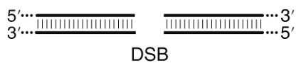
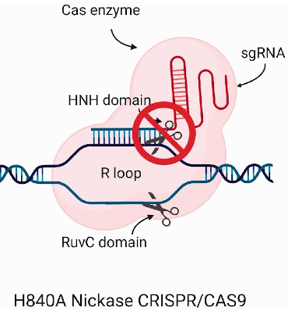
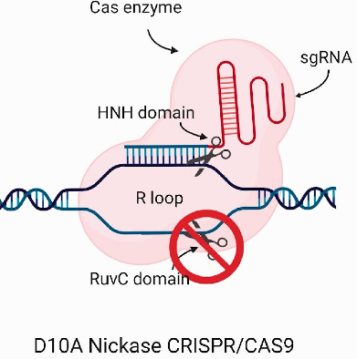
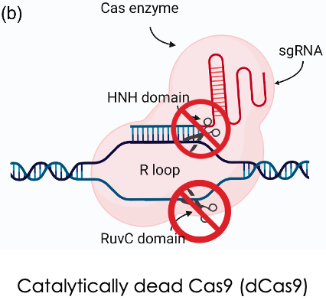
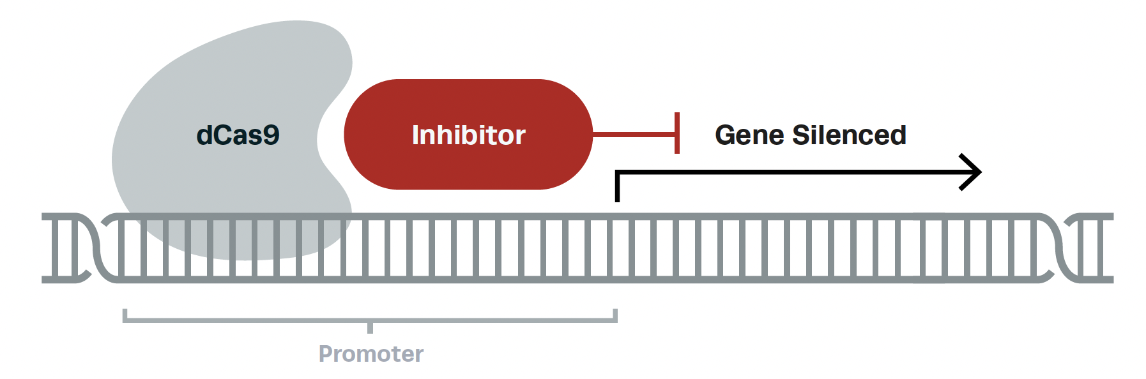
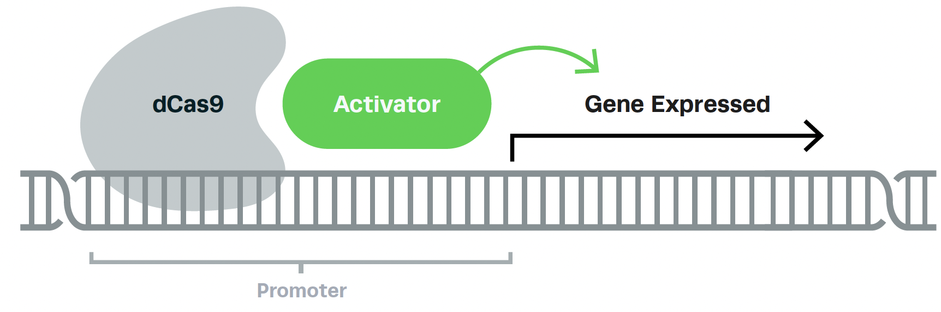
Genome editing without DSBs
Single Stranded Breaks (SSBs)
No Break
CRISPR interference (CRISPRi)
Base editors
Prime editors
CRISPR activation (CRISPRa)
Caso and Davies (2021) – Lab Anim.
Synthego
Notes:
The catalytically dead Cas9 (dCas9) can not edit but still binds to specific DNA sequences. Nickases are particularly useful for base editors and prime editors, and dCas9 can be exploited for various applications ranging from transcriptional regulation to epigenetic modifications.
CRISPR interference (CRISPRi): a technique using inactive Cas9 to silence or turn off gene expression without changing DNA sequence.
CRISPR activation (CRISPRa): a technique using inactive Cas9 to activate or turn on gene expression without changing DNA sequence.

Slide 9
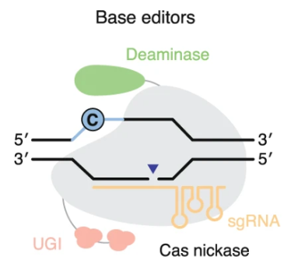
2) Genome editing with with base editors
Base editing directly installs point mutations into cellular DNA.
Without generating DSBs and excess undesired editing by-products.
Notes:
BE is a genome-editing approach that uses components from CRISPR systems together with other enzymes to. Base editors directly convert one base or base pair into another, enabling the efficient installation of point mutations in non-dividing cells without generating excess undesired editing by-products.
BEs are engineered to bypass the negative consequences mostly introduced by cellular DNA repair mechanisms because of DSBs formed by wild type Cas9.

Slide 10
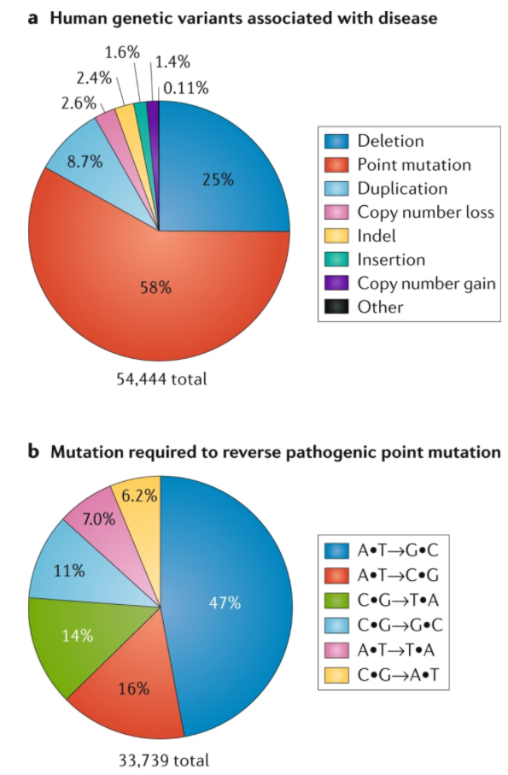
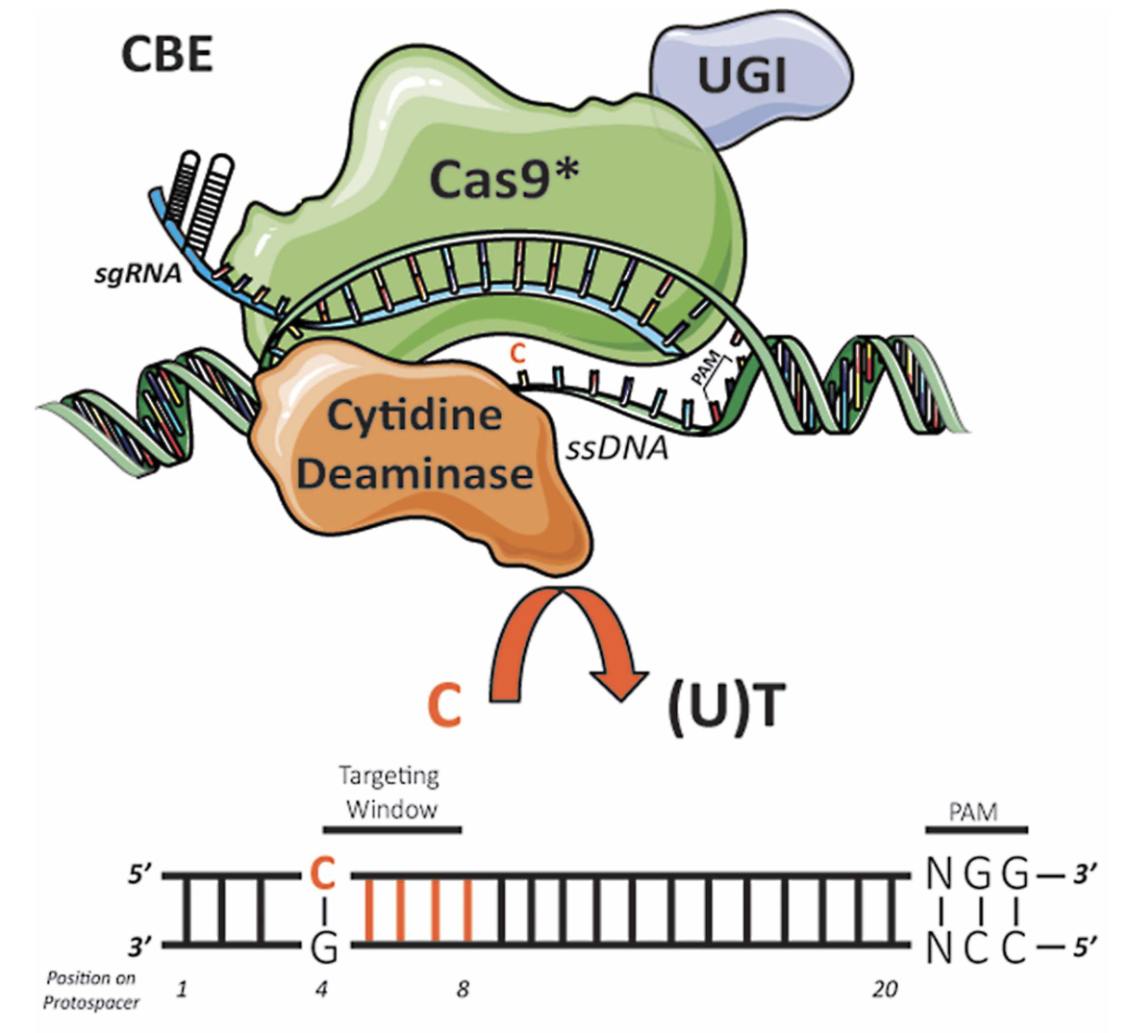
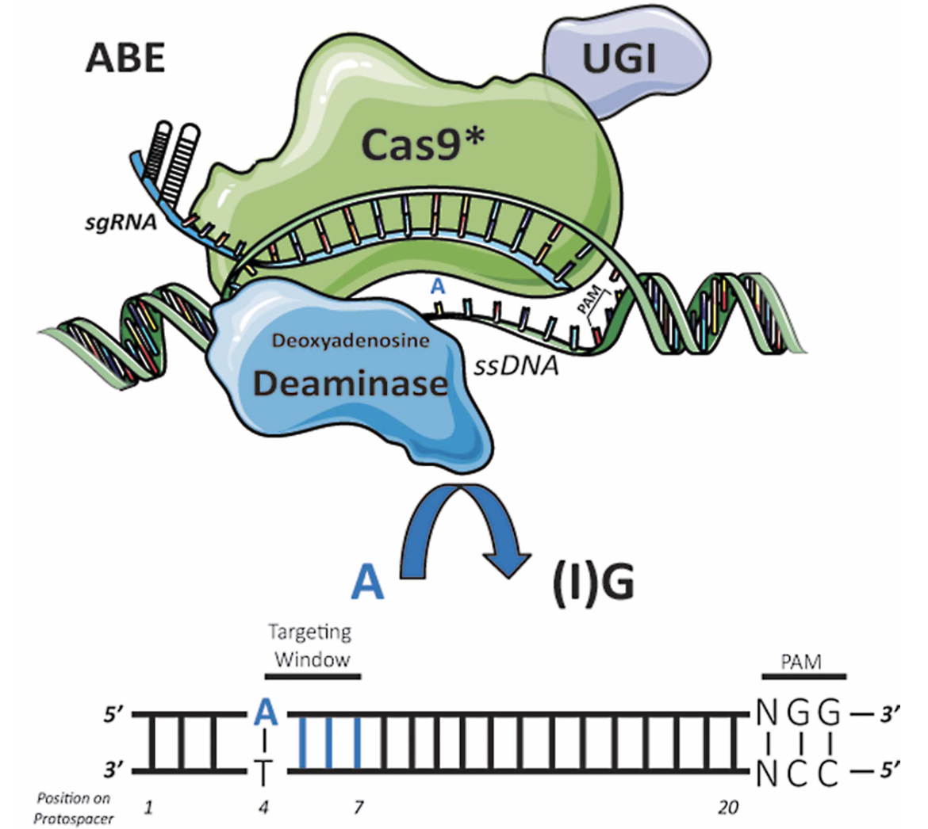
2) Genome editing with with base editors
The largest class of known human pathogenic mutations is the point mutations.
Two CRISPR DNA base editors, cytosine base editors (CBE) and adenine base editors (ABE) can edit most of the point mutations.
Transition mutations (61%)
Rees & Liu, Nature Reviews Genetics (2018)
Pal & Herold, Biochem Soc Trans (2021)
Notes:
Here in this pie chart we see the human genetic variants associated with disease based on the statistics from ClinVar database.
Installing or reversing pathogenic SNPs efficiently and cleanly is of great interest for the study and treatment of genetic disorders and requires a method to specifically change the sequence of an individual base pair within a vast genome.
In the second pie chart most of the point mutations are transition mutations which can be targeted with current DNA base editors.

Slide 11
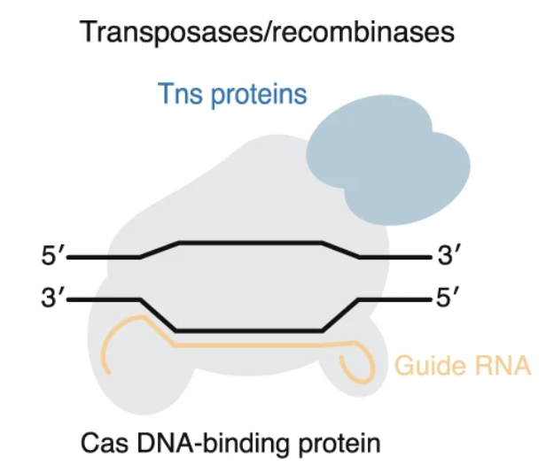
3) Genome editing with Transposases/Recombinases
Promising for large insertions (> 30 bp) for both in in-vitro and in a bacterial system however its use in an animal cells or in-vivo are yet to be determined.
Notes:
Transposase is an enzyme that binds to the end of a transposon which are known as or jumping gene that can change its position within a genome.

Slide 12
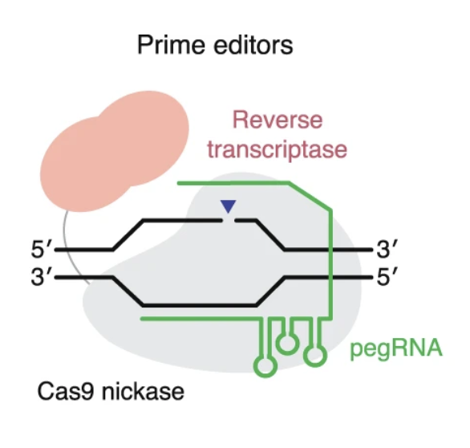
4) Genome editing with Prime Editors (PEs)
Can perform all possible transition and transversion mutations, targeted insertions and deletions in human cells without introducing DNA double stranded breaks.
Notes:
Prime editing is another alternative genome editing strategy that involves targeted change in the genetic information at the specified target sites by using a fusion protein (nickase and reverse transcriptase) guided by a peg RNA (Prime Editing Guide RNA). It is one of the novel genome editing technique that can perform all possible transitions mutations (C-T T-C, G-A, A-G), transversion mutations (C-A, C-G, G-C, G-T, A-C, A-T, T-A, A-T), targeted insertions and deletions in human cells without introducing DNA double stranded breaks

Slide 13
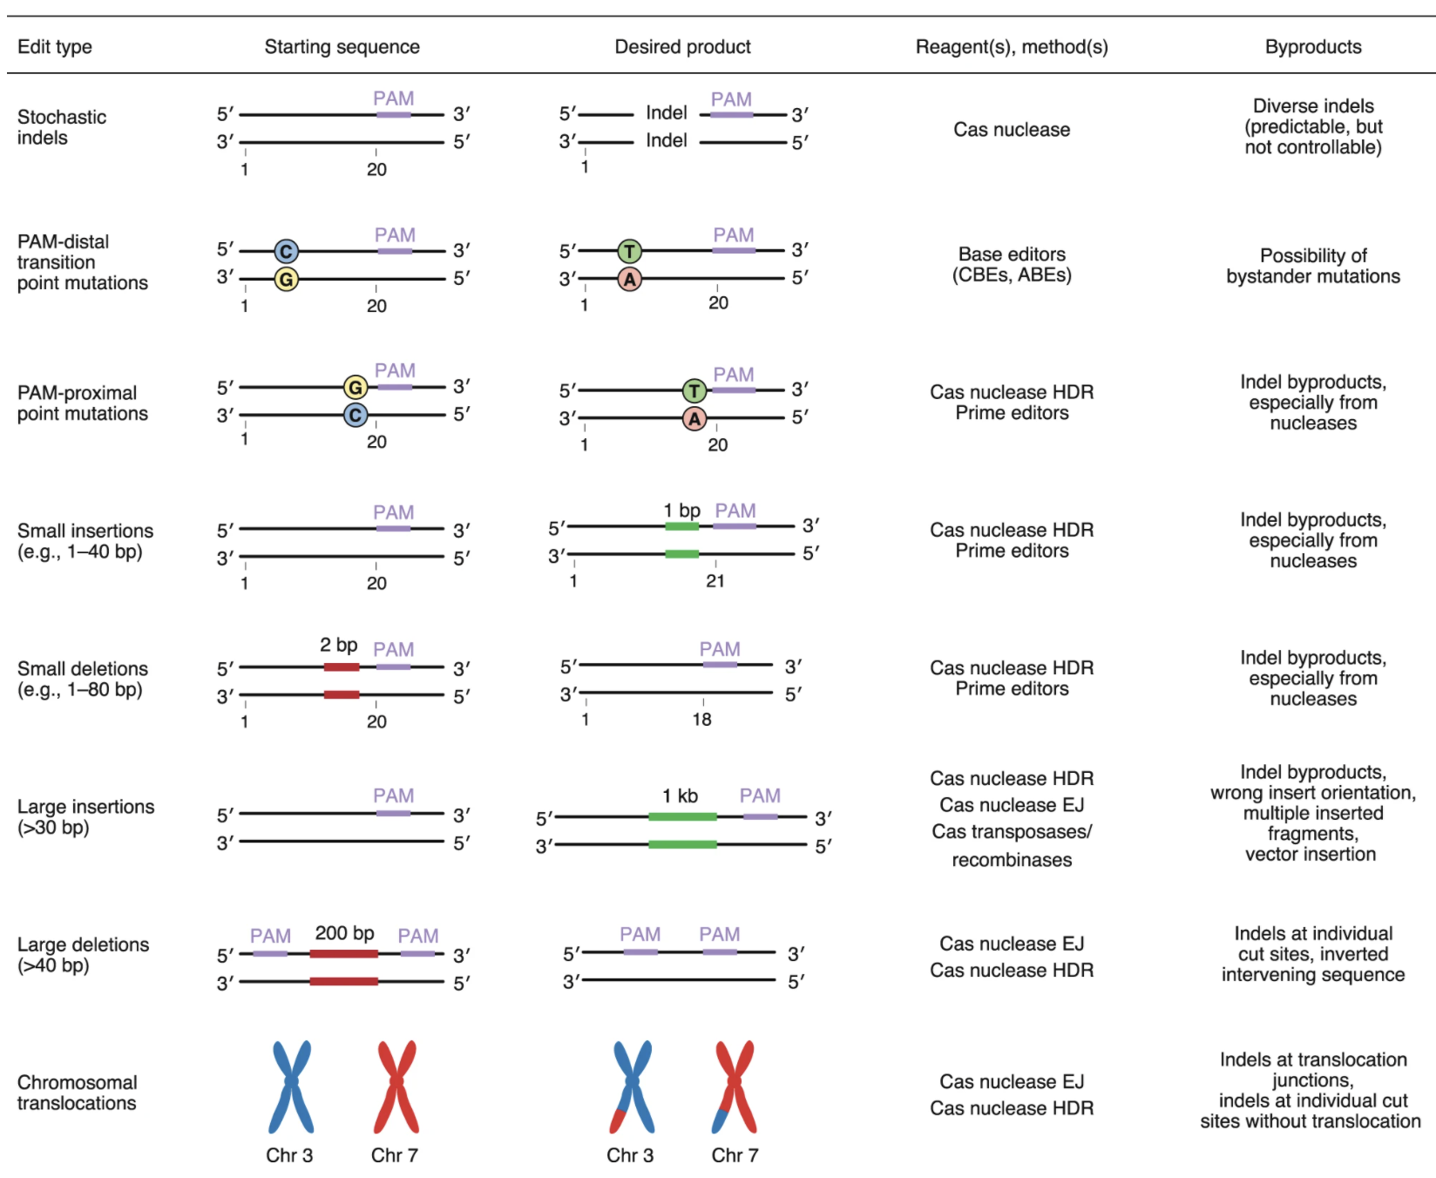
Part I summary: Overview of genome editing strategies and agents
Anzalone et al. (2020) – Nat Biotechnol.

Slide 14
Outline
Part I: Mechanisms of CRISPR/Cas-based systems
Part II: Developing a CRISPR/Cas screen
Workflow for designing and executing CRISPR screens
Workflow for analyzing NGS data from CRISPR screens
Part III: Example CRISPR analysis with edgeR and MAGeCK
Notes:
My talk consists of 4 parts. In the first part I will briefly describe the existing CRISPR/Cas-based systems. In the second part of my talk, I will focus on developing a CRISPR system and in the third part I will highlight some of the computational challenges we face. Then I will introduce you the base editors and our on-going work on designing guides for those editors.

Slide 15
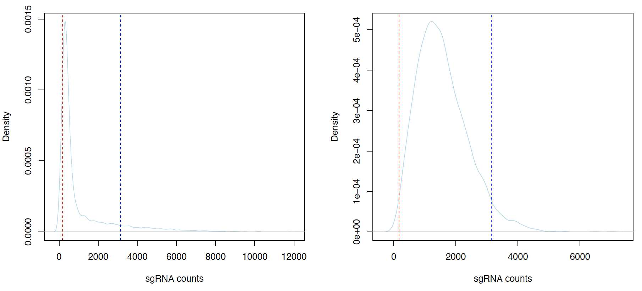
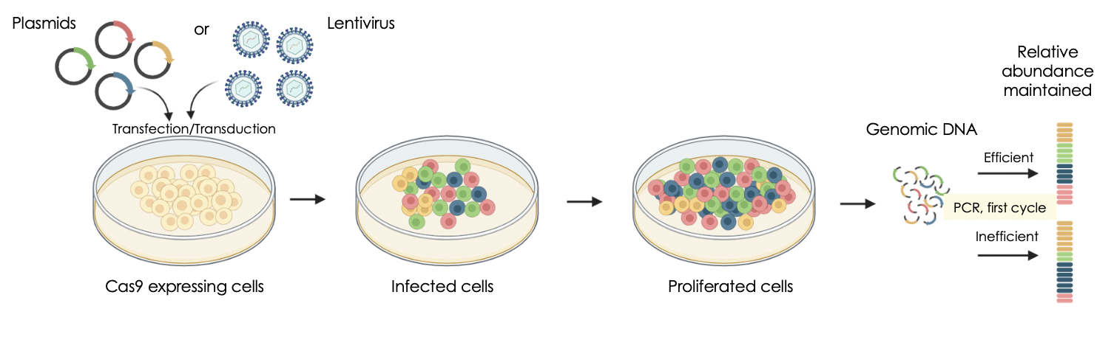

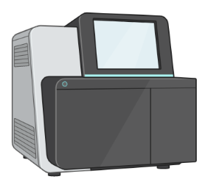
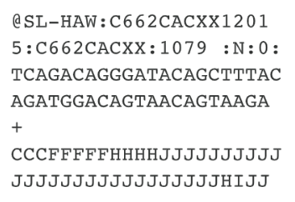
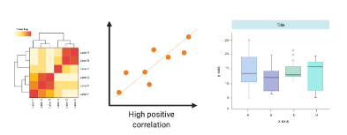
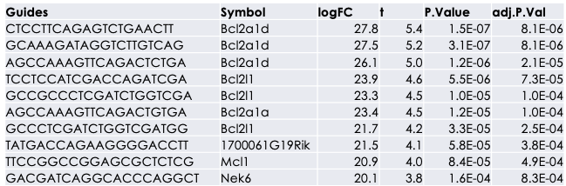
Developing a CRISPR screen: Design, execute and analyze
Workflow for designing and executing CRISPR screens
1
Choose single guide RNA library
2
Check the quality of sgRNA library
3
Maintain sgRNA representation
Workflow for analyzing NGS data from CRISPR screens
1
Obtaining raw read counts
2
Pre-process the data
3
Identify the hit genes
Next-gen sequencing
FASTQ files
Notes:
These are the steps a computational biologists can be involved and help you with the design your experiment to obtain high-quality throughput.

Slide 16
Workflow for designing and executing CRISPR screens

Slide 17
1) Choose CRISPR single guide RNA library
Choose a guide library from a viral vector repository based on the CRISPR/Cas9 system used for the screen.
For ex, AddGene, a nonprofit plasmid and viral vector repository, provides genome-wide CRISPR knockout, knockin, base editor libraries for human and murine experiments.

Slide 18
2) Check the quality of sgRNA library
Let’s assume you prepared a library and sequenced them to check if the quality of the prepared library is satisfying. We expect sgRNA counts to be normally distributed (i.e. follow the bell-shaped curve)
Bad representation
Good representation
Notes:
dashed lines at 10% (red) and 90% (blue) data points. Density plot on the left indicates that there are quite many large counts that are far from the center of the distribution. So even the density plot is narrower than chromatin library’s density, TF has a large variation in the data.

Slide 19
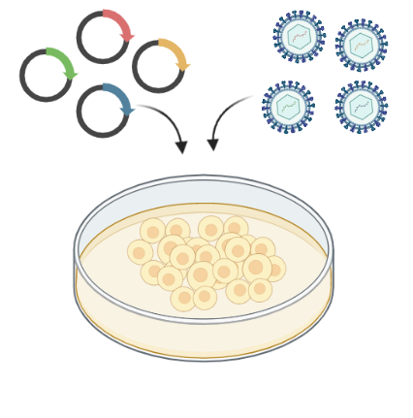
3) Maintain sgRNA representation
i) Determine the multiplicity of infection (MOI) which refers to the number of viral particle(s) present relative to host cell(s).
Plasmids
or
Lentivirus
100,000 viral particles
Transfection/Transduction
MOI = 0.1
One million cells
Cas9 expressing cells
Created with BioRender.com
Adapted from Doench, Nature Reviews (2017)
Notes:
Not every guide is as efficient in any given biological system. For example, if 100,000 viral particles are added to one million host cells, the MOI is 0.1. if one million viral particles are added to one million cells, the MOI is 1.
That being said, infecting at an MOI of 1.0 does not guarantee that all host cells will become infected/transduced.

Slide 20
3) Maintain sgRNA representation
i) Determine the multiplicity of infection (MOI) which refers to the number of viral particle(s) present relative to host cell(s).
Plasmids
or
Lentivirus
One million viral particles
Transfection/Transduction
MOI = 1
One million cells
Cas9 expressing cells
Infecting at an MOI of 1 does not guarantee that all host cells will become infected/transduced.
Created with BioRender.com
Adapted from Doench, Nature Reviews (2017)
Notes:
That being said, infecting at an MOI of 1.0 does not guarantee that all host cells will become infected/transduced.

Slide 21
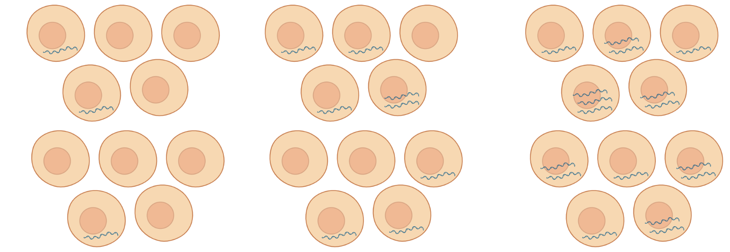
3) Maintain sgRNA representation
i) Determine an MOI at the infection efficiency of 20-60%
Infection efficiency
Low MOI
Optimal MOI
High MOI
Adapted from10X Genomics
Notes:
Pooled screens aim to balance a reasonably high infection efficiency, so that large numbers of cells are not discarded because they were not infected, while also minimizing the number of cells that receive more than one perturbation, because multiple integrants can add noise to most pooled screens. Thus, 5% or 95% infection efficiencies are too low and too high, respectively, whereas an efficiency of 20–60% provides a good balance.

Slide 22
3) Maintain sgRNA representation
i) Determine an MOI at the infection efficiency of 20-60%
Infection efficiency
Low MOI
Optimal MOI
High MOI
Adapted from10X Genomics
Notes:
Pooled screens aim to balance a reasonably high infection efficiency, so that large numbers of cells are not discarded because they were not infected, while also minimizing the number of cells that receive more than one perturbation, because multiple integrants can add noise to most pooled screens. Thus, 5% or 95% infection efficiencies are too low and too high, respectively, whereas an efficiency of 20–60% provides a good balance.

Slide 23
3) Maintain sgRNA representation
i) Determine an MOI at the infection efficiency of 20-60%
Infection efficiency
Low MOI
Optimal MOI
High MOI
Adapted from10X Genomics
Notes:
Pooled screens aim to balance a reasonably high infection efficiency, so that large numbers of cells are not discarded because they were not infected, while also minimizing the number of cells that receive more than one perturbation, because multiple integrants can add noise to most pooled screens. Thus, 5% or 95% infection efficiencies are too low and too high, respectively, whereas an efficiency of 20–60% provides a good balance.

Slide 24
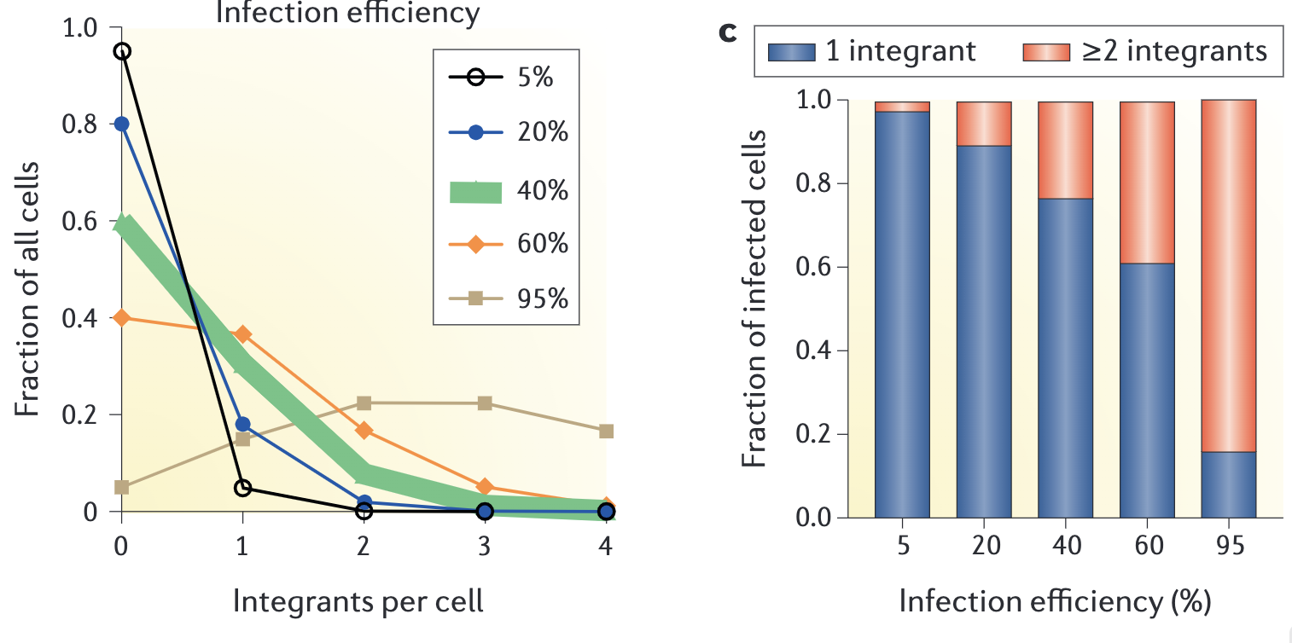
3) Maintain sgRNA representation
i) Determine an MOI at the infection efficiency of 20-60%
P(k) = e^{-λ}λ^{k}/k!
λ is the MOI
k is the number of viral particles in each cell and takes values 0, 1, 2, etc.
MOI
Doench, Nature Reviews (2017)
Notes:
To estimate the number of cells transduced, the Poisson distribution equation is needed:
P(k) = e^{-λ}λ^{k}/k!
is the MOI
k is the number of viral particles and takes values 0, 1, 2, etc.
> exp(-0.4)*0.4^0/factorial(0)
[1] 0.67032
> exp(-0.4)*0.4^1/factorial(1)
[1] 0.268128
> exp(-0.4)*0.4^2/factorial(2)
[1] 0.0536256
> exp(-0.4)*0.4^3/factorial(3)
[1] 0.00715008
So in the second bar chart, when the number of infected cells increase to 95% then most cells will be doubly infected.

Slide 25
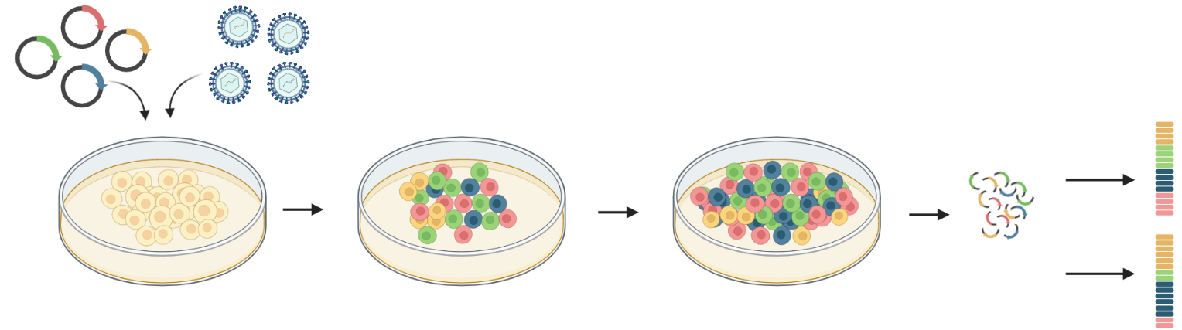
3) Maintain sgRNA representation
ii) Decide fold representation of the guides
Plasmids
or
Lentivirus
Relative abundance maintained
Transfection/Transduction
Prepare genomic
DNA
Selection
Proliferation
Efficient
PCR, first cycle
Inefficient
Cas9 expressing cells
Infected cells
Proliferated cells
Created with BioRender.com
Adapted from Doench, Nature Reviews (2017)
Notes:
A schematic of infection and cell passaging is presented.
PCR conditions and genomic DNA quality should be optimized to ensure that each sgRNA integrant serves as a template for amplification.
Representation is maintained rather than simply increasing the number of PCR cycles to achieve more product from only a fraction of the integrants.

Slide 26
3) Maintain sgRNA representation
ii) Decide fold representation of the guides
Number of sgRNA
x
Fold representation
=
Number of infected cells
Plasmids
or
Lentivirus
Relative abundance maintained
Transfection/Transduction
Prepare genomic
DNA
Selection
Proliferation
Efficient
PCR, first cycle
Inefficient
Cas9 expressing cells
Infected cells
Proliferated cells
Number of infected cells
/
Infection efficiency
=
Number of starting cells
Created with BioRender.com
Adapted from Doench, Nature Reviews (2017)
Notes:
An example calculation of the number of cells needed to maintain representation of the library. For a high-quality library, 300–1000-fold representation is typical. This representation should be maintained throughout the screen and during library preparation.

Slide 27
Workflow for analyzing CRISPR screens

Slide 28
Analyzing CRISPR screens: Counting the reads
Obtaining read counts
Next-gen sequencing
FASTQ files
Guide RNA counts
Filtering
Samples
Count matrix
Normalization
Guides
DE at guide level
Aligners: Rsubread, Bowtie, etc.
Alignment free quantifiers: Salmon, Jellyfish
DE at gene level
Notes:
mapping reads to the guide sequences in the CRISPR library and building a table of read counts
Next-generation sequencing returns FASTQ files; during deconvolution, the number of sequencing reads per guide is counted to obtain raw read counts.
Level of sequencing depth?After library preparation, a further consideration issequencing depth. The necessary sequencing depthrequired to achieve adequate interrogation of thelibrary complexity will be different for each CRISPRlibrary and screen. Based on data from our screens aswell as others, 1–29107reads is more than sufficientto adequately sequence a complex library of~19105elements at the plasmid or baseline infected cell popu-lation level. In the case of positive selection screenwith strong selective pressure, useful results can beobtained with only a few million reads. However, neg-ative selection screens, where most cells survive andchanges in representation may be subtle, may requiremuch deeper sequencing up to 19108reads.

Slide 29
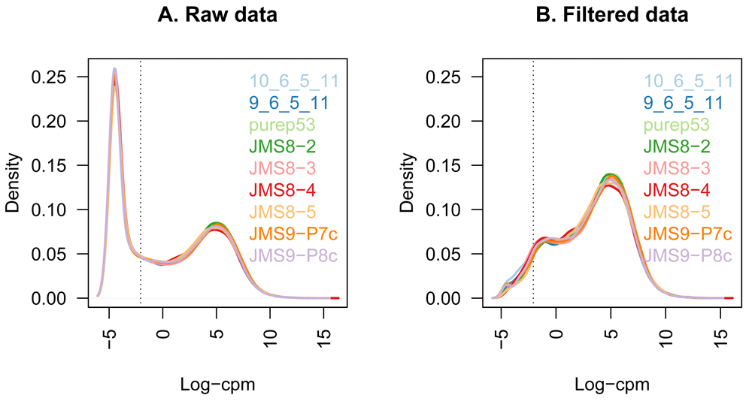
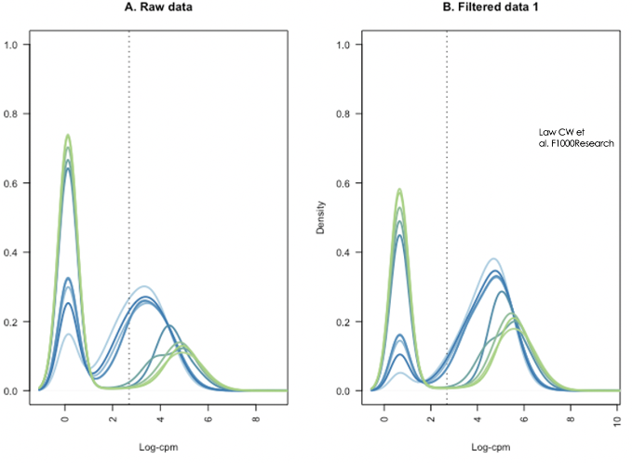
Analyzing CRISPR screens: Filtering lowly expressed guides
Obtaining read counts
Filtering
Law CW et al. F1000Research
Standard RNA-Seq
Normalization
DE at guide level
Guide RNA counts from NGS
DE at gene level
Notes:
Next-generation sequencing returns FASTQ files; during deconvolution, the number of sequencing reads per guide is counted to obtain raw read counts.
Level of sequencing depth?After library preparation, a further consideration issequencing depth. The necessary sequencing depthrequired to achieve adequate interrogation of thelibrary complexity will be different for each CRISPRlibrary and screen. Based on data from our screens aswell as others, 1–29107reads is more than sufficientto adequately sequence a complex library of~19105elements at the plasmid or baseline infected cell popu-lation level. In the case of positive selection screenwith strong selective pressure, useful results can beobtained with only a few million reads. However, neg-ative selection screens, where most cells survive andchanges in representation may be subtle, may requiremuch deeper sequencing up to 19108reads.

Slide 30
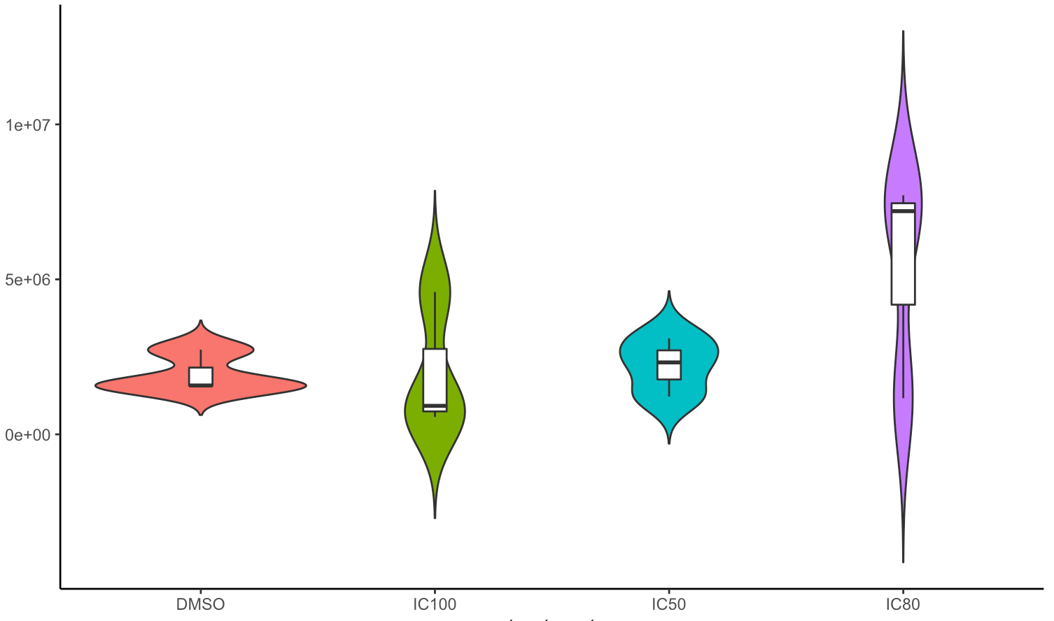
Analyzing CRISPR screens: Library size normalization
Library Sizes
Obtaining read counts
DMSO
Treated samples
Filtering
Guide RNA counts
Samples
Normalization
Count matrix
Guides
DE at guide level
DMSO
Treated samples
DE at gene level
Notes:
The goal of library size normalization is to make the library sizes comparable by scaling raw read counts in each sample by a single sample-specific factor reflecting its library size.
Next-generation sequencing returns FASTQ files; during deconvolution, the number of sequencing reads per guide is counted to obtain raw read counts.
Level of sequencing depth?After library preparation, a further consideration issequencing depth. The necessary sequencing depthrequired to achieve adequate interrogation of thelibrary complexity will be different for each CRISPRlibrary and screen. Based on data from our screens aswell as others, 1–29107reads is more than sufficientto adequately sequence a complex library of~19105elements at the plasmid or baseline infected cell popu-lation level. In the case of positive selection screenwith strong selective pressure, useful results can beobtained with only a few million reads. However, neg-ative selection screens, where most cells survive andchanges in representation may be subtle, may requiremuch deeper sequencing up to 19108reads.

Slide 31
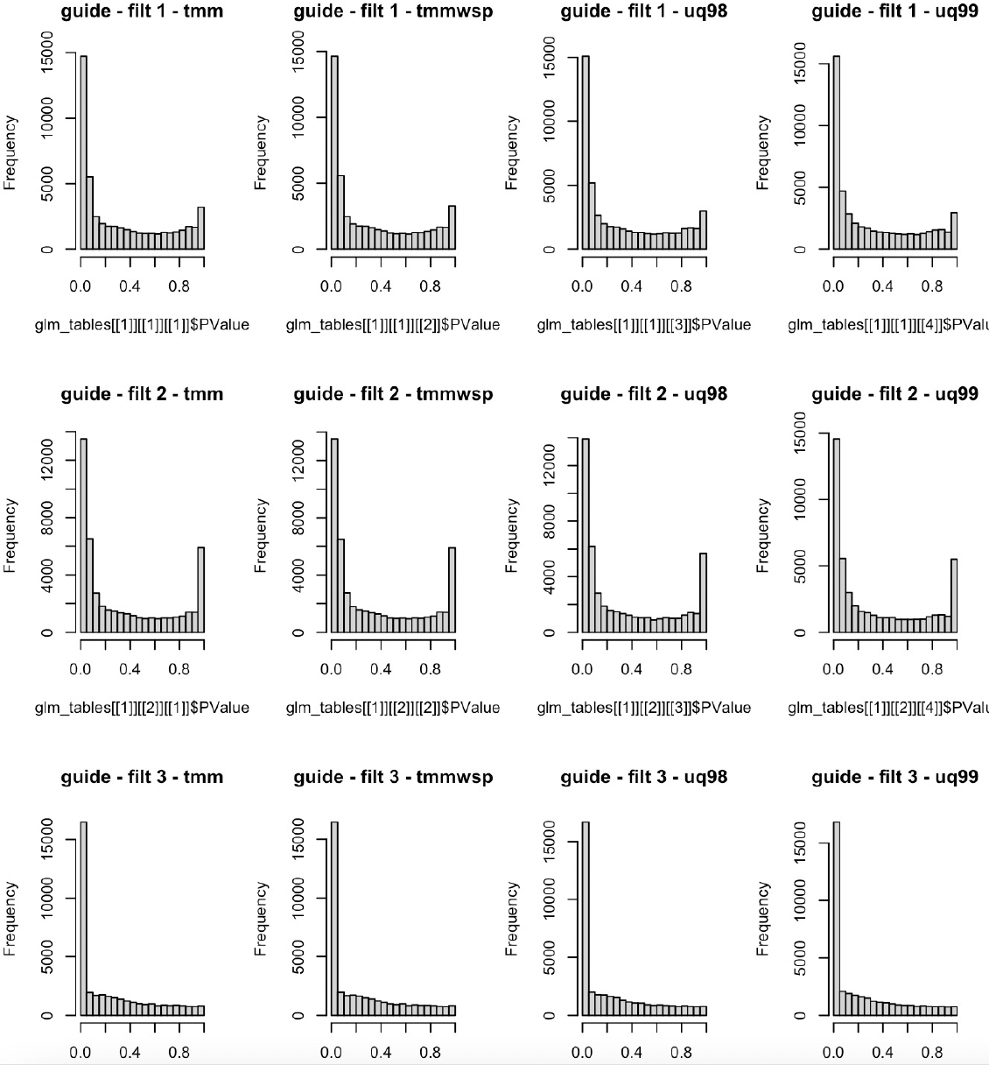
Analyzing CRISPR screens: Differential expression (DE) P-value histograms
1st normalization approach
2nd normalization approach
3rd normalization approach
4th normalization approach
Obtaining read counts
1st filtering approach
Filtering
The R package edgeR is used for statistical modelling
Normalization
^{2nd} filtering approach
Robinson MD et al. Bioinformatics (2010)
McCarthy DJ et al. NAR (2012)
Chen Y et al., F1000research (2016)
DE at guide level
DE at gene level
^{3rd} filtering approach
Notes:
Next-generation sequencing returns FASTQ files; during deconvolution, the number of sequencing reads per guide is counted to obtain raw read counts.
Level of sequencing depth?After library preparation, a further consideration issequencing depth. The necessary sequencing depthrequired to achieve adequate interrogation of thelibrary complexity will be different for each CRISPRlibrary and screen. Based on data from our screens aswell as others, 1–29107reads is more than sufficientto adequately sequence a complex library of~19105elements at the plasmid or baseline infected cell popu-lation level. In the case of positive selection screenwith strong selective pressure, useful results can beobtained with only a few million reads. However, neg-ative selection screens, where most cells survive andchanges in representation may be subtle, may requiremuch deeper sequencing up to 19108reads.

Slide 32
Analyzing CRISPR screens: DE at gene level
Obtaining read counts
Gene-wise p-values are computed utilizing gene set test approaches, like FRY and ROAST or ranking genes similar to gene set enrichment approaches.
Filtering
Normalization
DE at guide level
DE at gene level
Notes:
Next-generation sequencing returns FASTQ files; during deconvolution, the number of sequencing reads per guide is counted to obtain raw read counts.
Level of sequencing depth?After library preparation, a further consideration issequencing depth. The necessary sequencing depthrequired to achieve adequate interrogation of thelibrary complexity will be different for each CRISPRlibrary and screen. Based on data from our screens aswell as others, 1–29107reads is more than sufficientto adequately sequence a complex library of~19105elements at the plasmid or baseline infected cell popu-lation level. In the case of positive selection screenwith strong selective pressure, useful results can beobtained with only a few million reads. However, neg-ative selection screens, where most cells survive andchanges in representation may be subtle, may requiremuch deeper sequencing up to 19108reads.

Slide 33
Part II summary
Library design
Start with a good quality guide RNA library.
For a high-quality library, 300 -1000-fold representation is typical.
Choice of optimal MOI and fold representation will increase the accuracy of the results.
Screen analyses
Quantification of reads may be improved by using a quantifier rather than a standard aligner.
Appropriate filtering seems to be an important step.
CRISPR specific normalization methods are needed.
Notes:
For ahigh quality library, 300–1000-fold representation is typical. This representation should be maintained throughout the screen and during library preparation. To reach and maintain the suggested fold representation during a screen, it involves multiple variables dependent on the cell line being utilized and the screen itself. For most screens performed to date, however, approximately 100–200 million cells are transduced and subsequently screened [10,11]. Typically, the progression of a screen involves many tens of culture plates/flasks and hours of tissue culture on seeding and harvesting days.

Slide 34
Outline
Part I: Mechanisms of CRISPR/Cas-based systems
Part II: Developing a CRISPR/Cas screen
Workflow for designing and executing CRISPR screens
Workflow for analyzing NGS data from CRISPR screens
Part III: Example CRISPR analysis with edgeR and MAGeCK
Notes:
My talk consists of 4 parts. In the first part I will briefly describe the existing CRISPR/Cas-based systems. In the second part of my talk, I will focus on developing a CRISPR system and in the third part I will highlight some of the computational challenges we face. Then I will introduce you the base editors and our on-going work on designing guides for those editors.

Slide 35
MAGeCK
MAGeCK count
counts the sgRNAs on your sequencing files
trims the known adapters automatically with –-trim-5
if the adapters are not known, trim the adapters manually (cutadapt, …)
MAGeCK test (RRA – Robust Ranking Algorithm)
Allows you to compare only two conditions
It is faster than MAGeCK mle
MAGeCK mle
To compare two or more conditions
To analyse more complex experimental designs

Slide 36
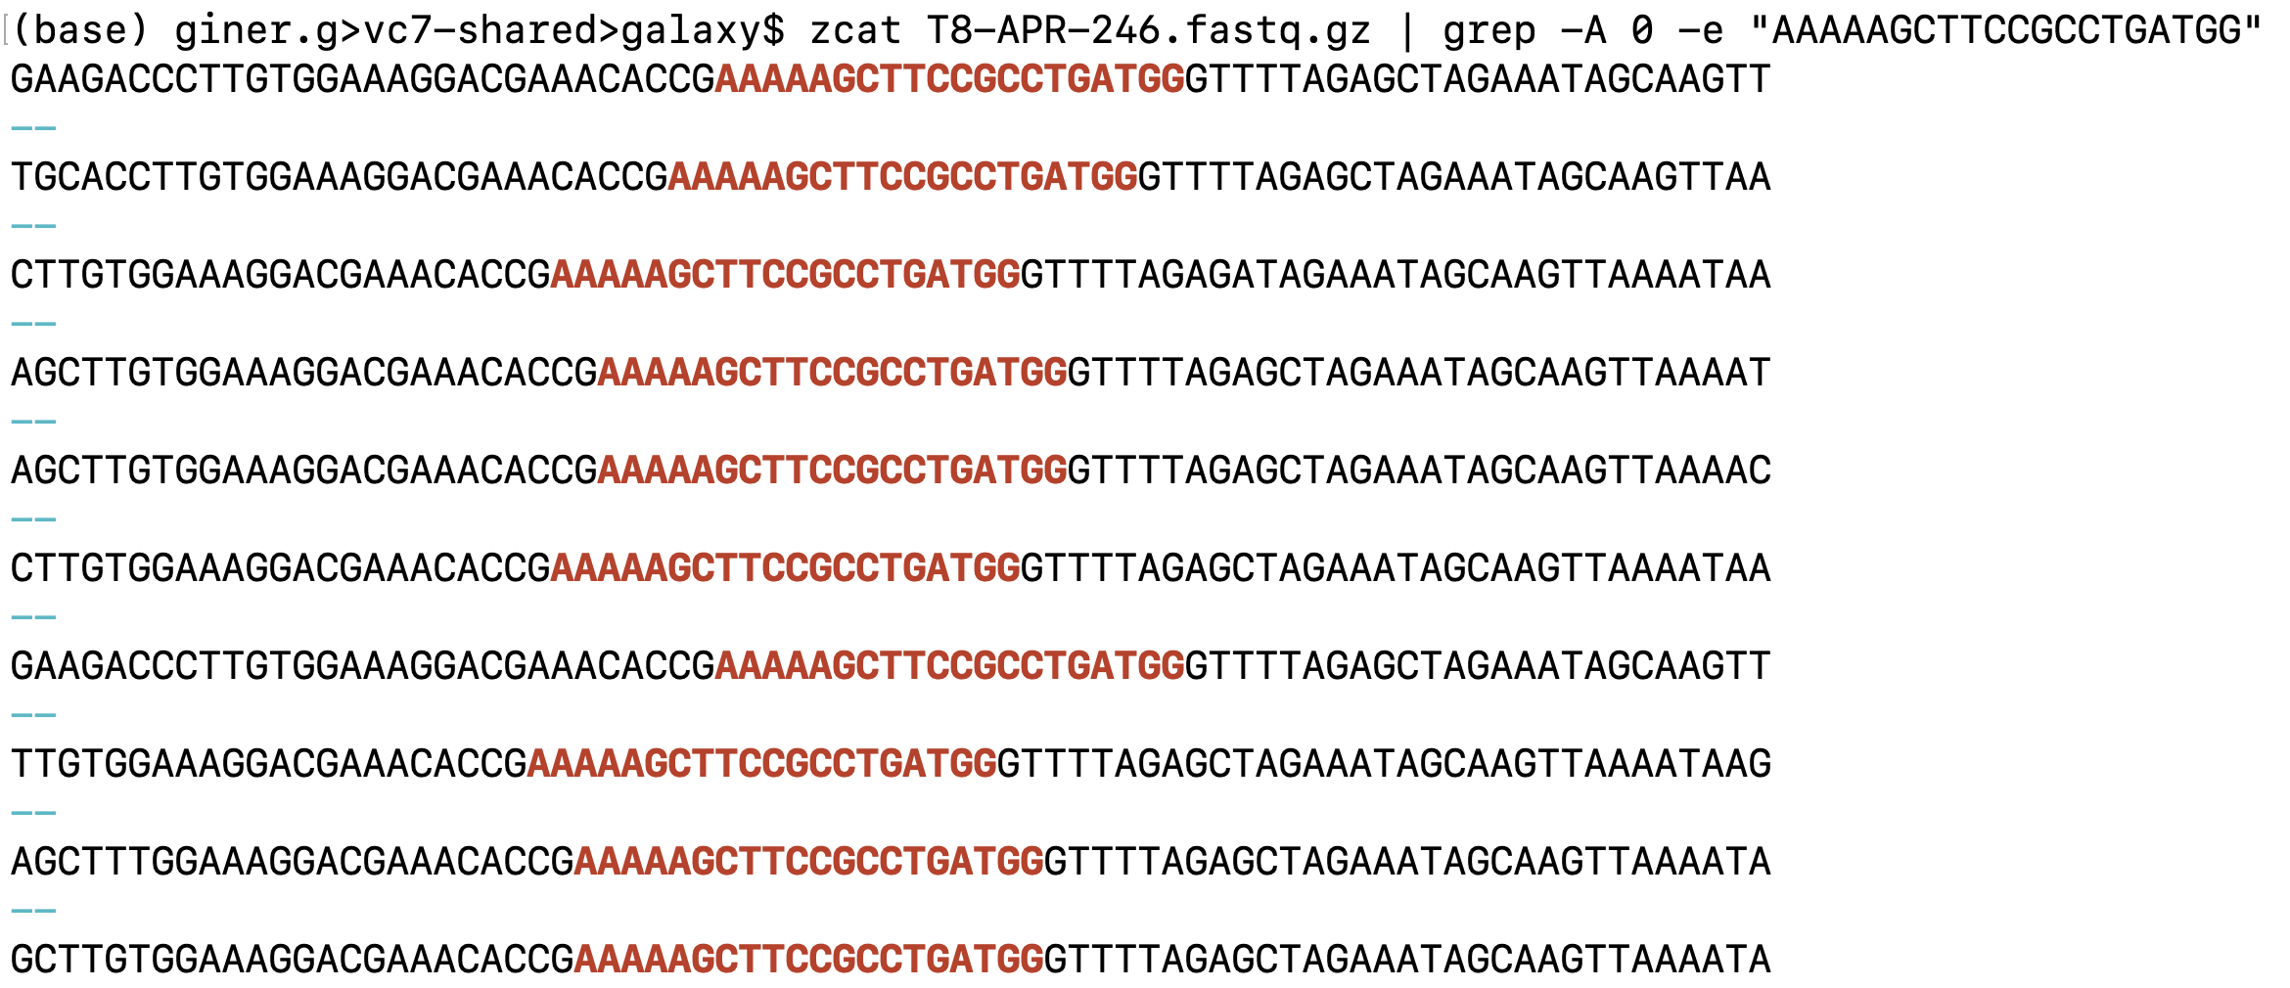
Trim the adapters on your sequencing data
MAGeCK automatically detects and trims the known 5` adapters and the stagger sequence prior to them.
Then it takes first 20bp of each line as it is the sgRNA sequence while counting the guides.
5` Adapters
3` Adapters
Notes:
With CRISPR screens we expect adapter sequence to be present, surrounding the guide.
Reads from the T8-APR-246 sample with one of the guide sequences highlighted in red (it is a controlguide1 from Brunello library file).
The 5` adapter sequences green underline, directly adjacent to the guide on the right and left.
The bases in black at the start of the reads are stagger regions of different length (0-8bp), required to maintain diversity across the flowcell during sequencing of CRISPR screens.

Slide 37
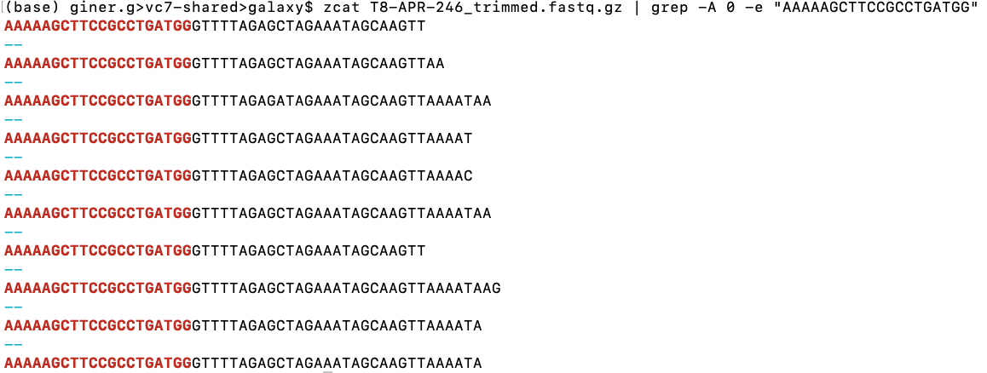
MAGeCK automatically detects and trims the known adapters

Slide 38
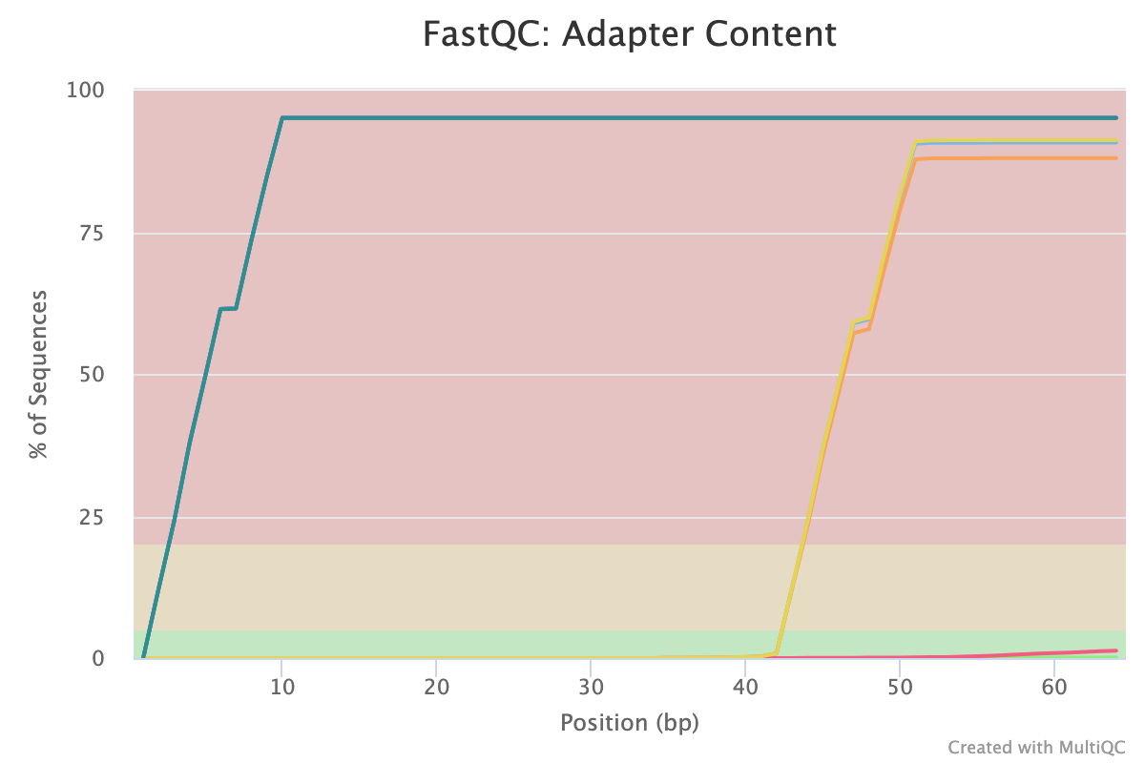
MAGeCK - Adapter Trimming
If MAGeCK cannot automatically detect the adapter sequence, you can trim 5` sequence for example ‘AACCGGTT’ using cutadapt as follows:
cutadapt -g AACCGGTT -o input_trimmed.fastq.gz input.fastq.gz

Slide 39
MAGeCK count
1. There is no replicate
mageck count --list-seq sgRNA_library.txt --sample-label Treatment,Control --fastq Treatment.fastq Control.fastq --output-prefix crispr_experiment
2. There are biological replicates
mageck count --list-seq sgRNA_library.txt --sample-label Treatment_biorep1,Treatment_biorep2,Control_biorep1,Control_biorep2 --fastq Treatment.fastq Control.fastq --output-prefix crispr_experiment-with-biorep
3. There are technical replicates
mageck count --list-seq sgRNA_library.txt --sample-label Treatment,Control --fastq Treatment_tecrep1.fastq, Treatment_tecrep1.fastq Control_techrep1.fastq, Control_tecrep2.fastq --output-prefix crispr_experiment-with-techrep

Slide 40
Introduction to Galaxy
Accessing Galaxy: Go to the Galaxy platform.
Downloading example datasets: T8-APR-246 T8-Vehicle.
Uploading data: Import your CRISPR data files (e.g., FASTQ files containing sequenced reads) into Galaxy. You can use the "Upload Data" tool for this.
Quality control: Use tools like FastQC/MultiQC to perform quality control on your sequencing data. This step helps ensure the reliability of your data.
Trimming and preprocessing: Trim low-quality bases and adapters using tools like Trimmomatic or Cutadapt. This step improves data quality.
Counting sgRNAs: Count guide RNAs with MAGeCK.
Identifying hits: Use Galaxy's tools to run MAGeCK.
Interpreting results: Visualize and interpret your results.
Pathway analysis: Identify the pathways enriched in the experiment.

Slide 41

1. Access Galaxy
Notes:
Galaxy is an open-source platform for data analysis in the life sciences. It provides a user-friendly web interface and a wide range of tools, including MAGeCK and edgeR to simplify data analysis.

Slide 42
2. Download example datasets
CRISPR screen data is obtained from Fujihara et al. 2020.
There are 3 samples from the human esophageal cancer cell line (OACM5.1): a baseline sample taken at time zero (T0-Control), a sample treated with drug for 8 days (T8-APR-246) and a control sample treated with vehicle for 8 days (T8-Vehicle).
The aim is to identify genes whose knockout increases the cancer cells sensitivity to the drug.
Notes:
Galaxy is an open-source platform for data analysis in the life sciences. It provides a user-friendly web interface and a wide range of tools, including MAGeCK and edgeR to simplify data analysis.

Slide 43

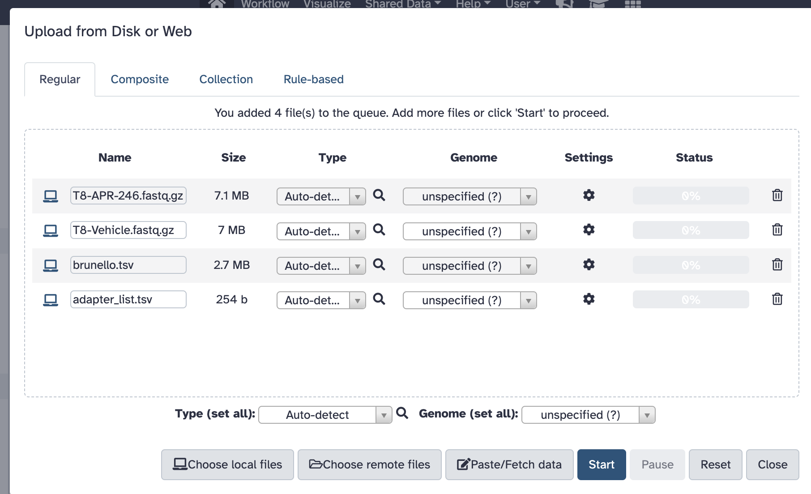
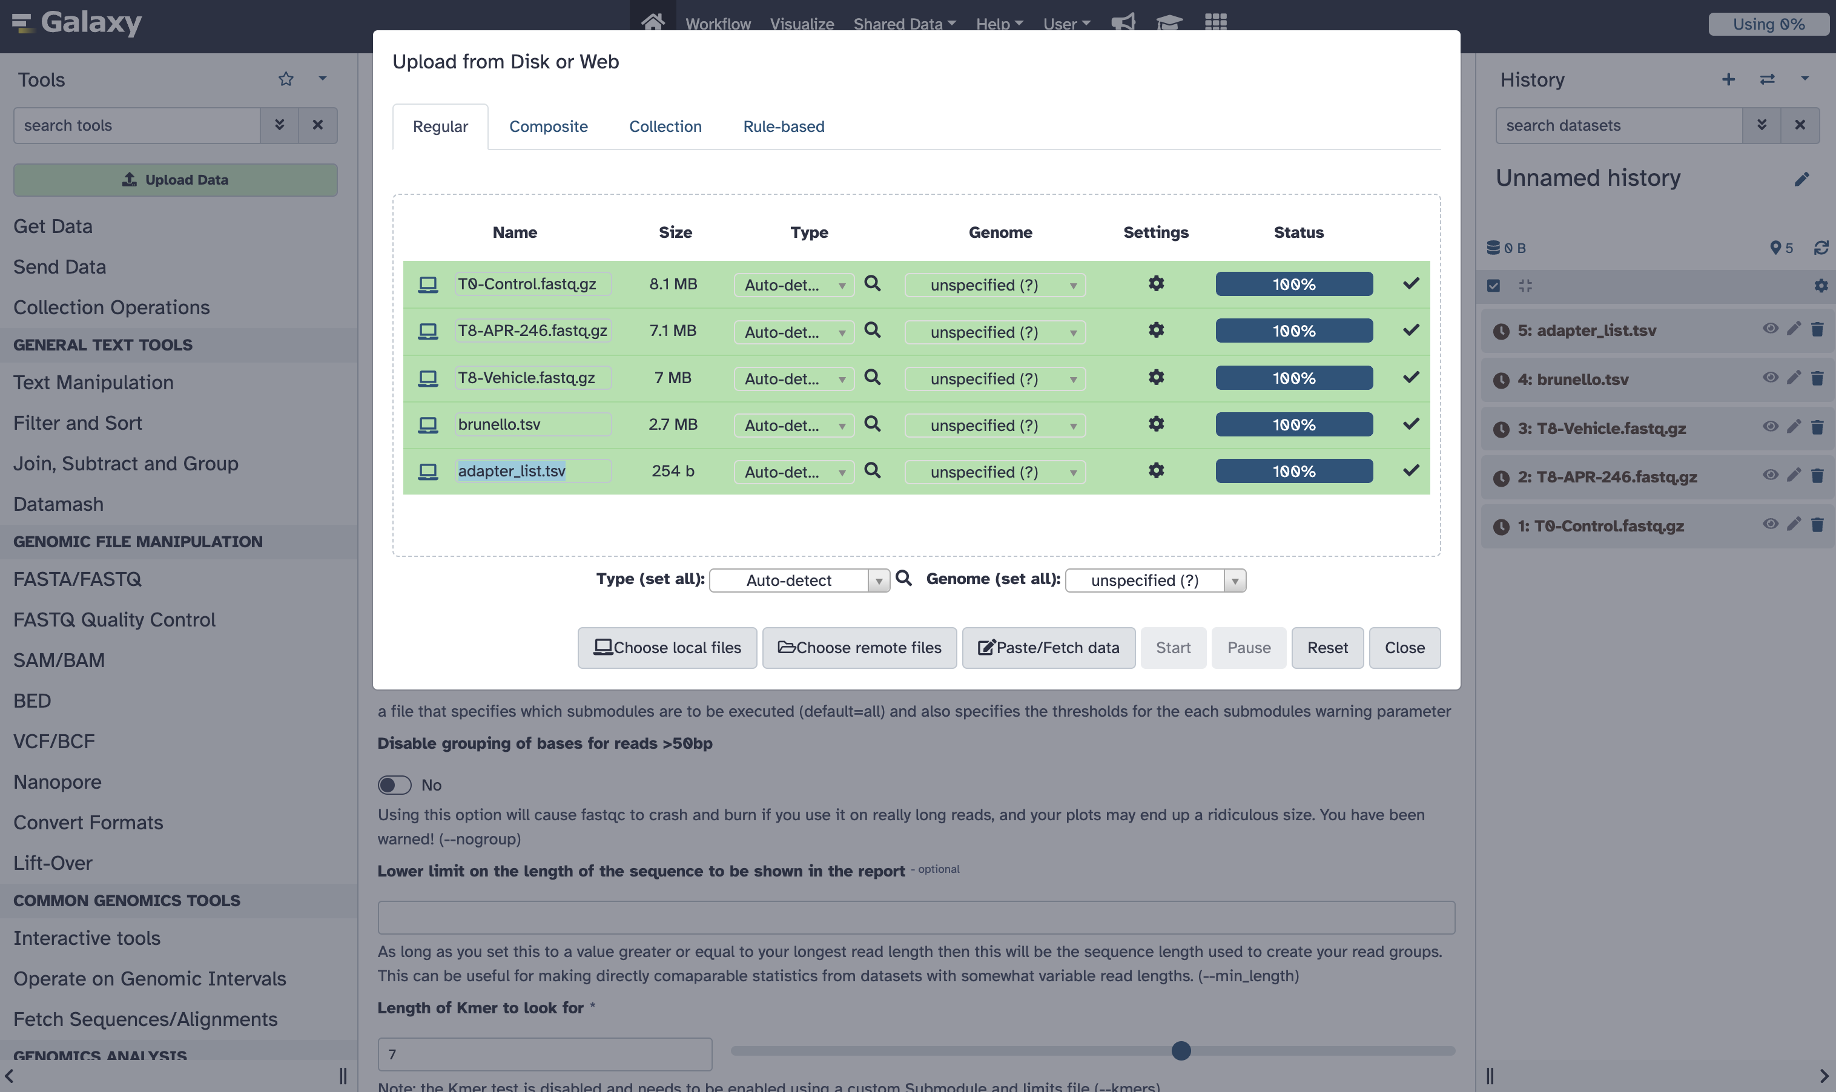
3. Upload data

Slide 44
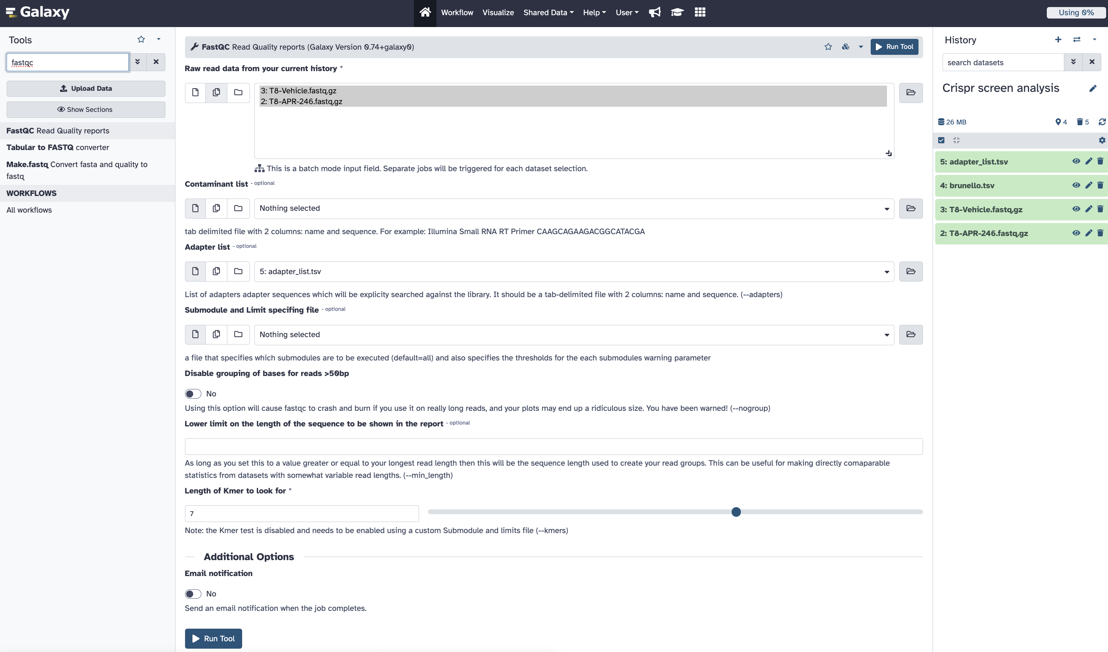
4. Quality control (FastQC)
Notes:
First we’ll check the quality of the raw read sequences with FastQC and aggregate the reports from the multiple samples with MultiQC. Fastqc will specifically look for these adapters. FastQC creates individual reports and using MultiQC we will aggregate those results for each sample.

Slide 45
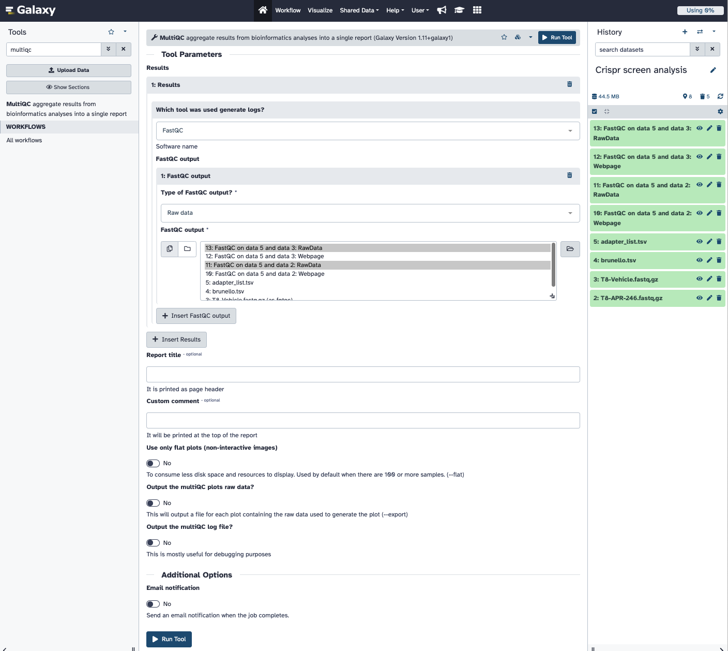
4. Quality control (MultiQC)
Notes:
First we’ll check the quality of the raw read sequences with FastQC and aggregate the reports from the multiple samples with MultiQC. Fastqc will specifically look for these adapters. FastQC creates individual reports and using MultiQC we will aggregate those results for each sample.

Slide 46
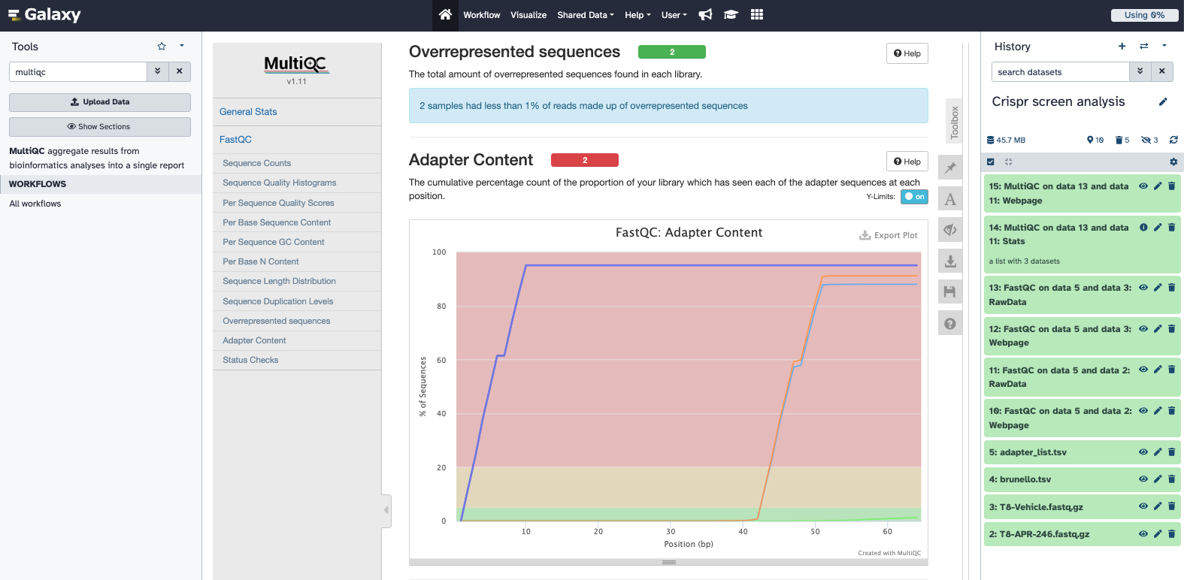
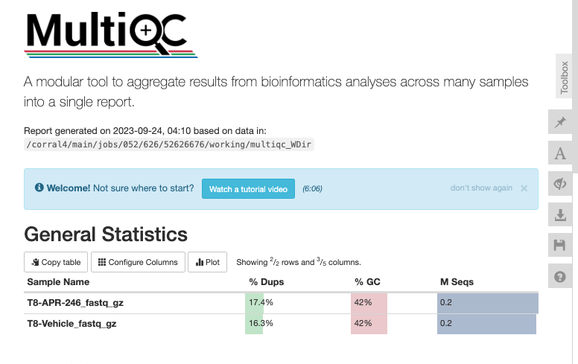
4. Quality control - MultiQC results
Notes:
This will give us a web page that will summarise our FastQC results for these two samples. X-axis is the length of the read, 60bp. At the beginning, some 5` adapters are detected. At the end, 3` adapters are detected. The red line is illumina adapters which might mean some short sequences or small amount of primer dimers are there.

Slide 47
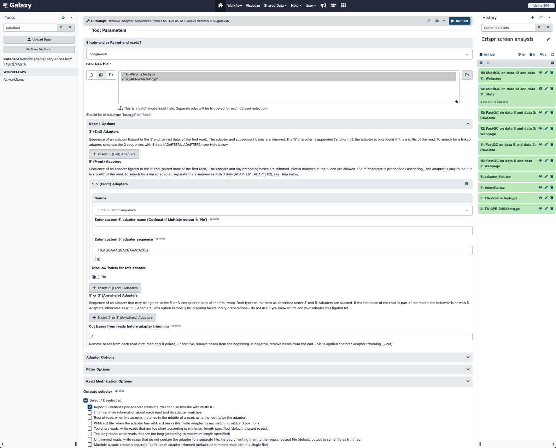
5. Trimming and preprocessing

Slide 48
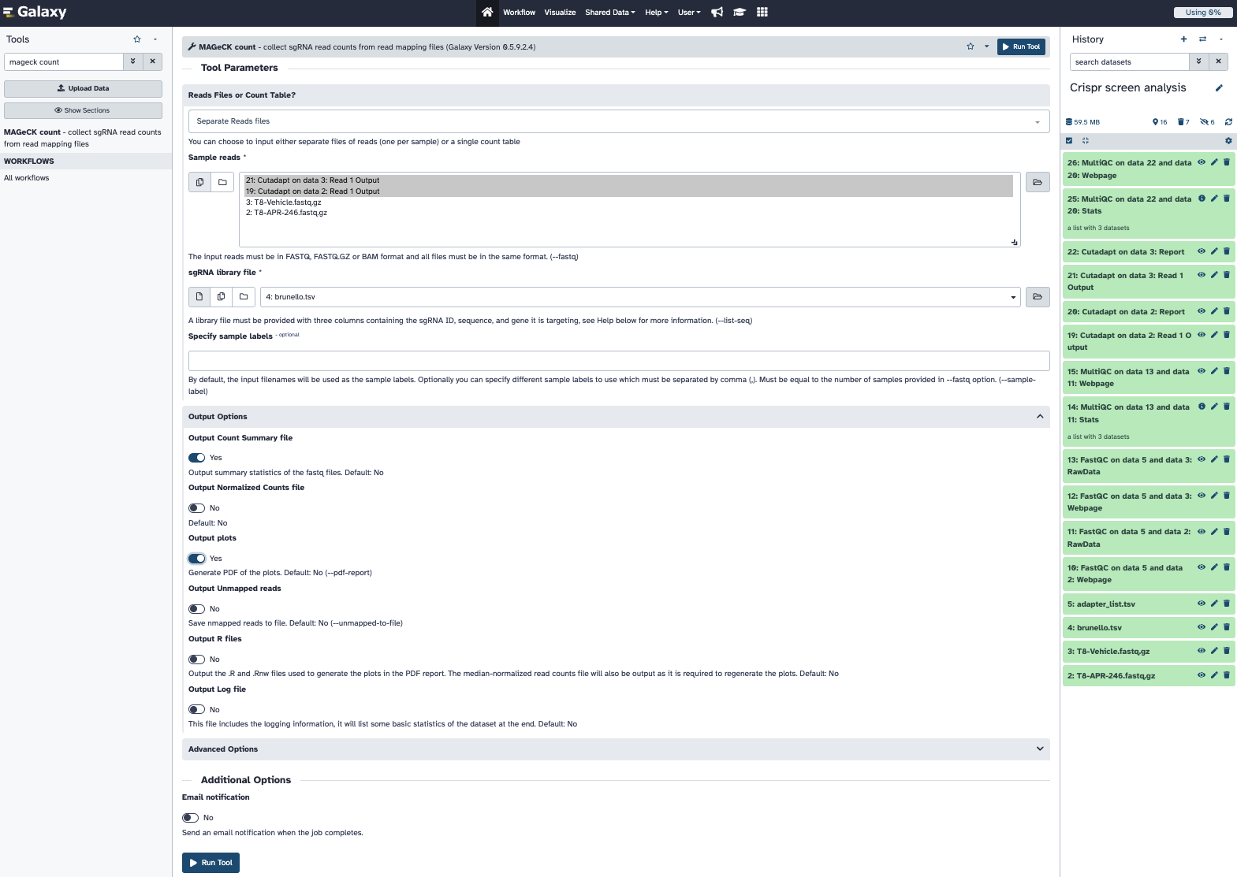
6. Counting sgRNAs – MAGeCK count
Notes:
To count how many guides we have for each gene, we need a library file that tells us which guide sequence belongs to which gene. The guides used here are from the Brunello library (Doench et al. 2016) which contains 77,441 sgRNAs, an average of 4 sgRNAs per gene, and 1000 non-targeting control sgRNAs.

Slide 49
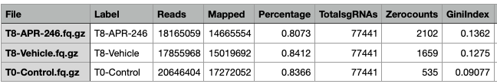
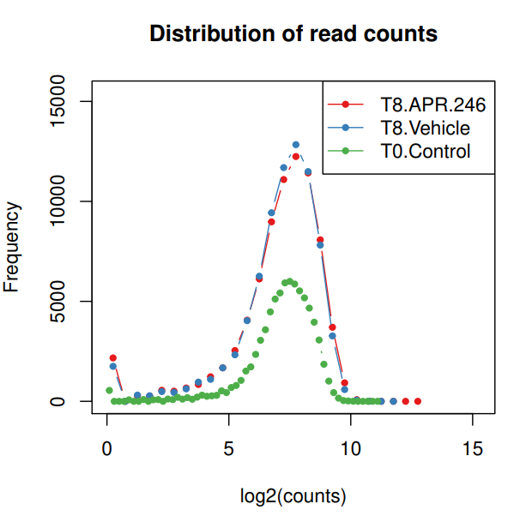
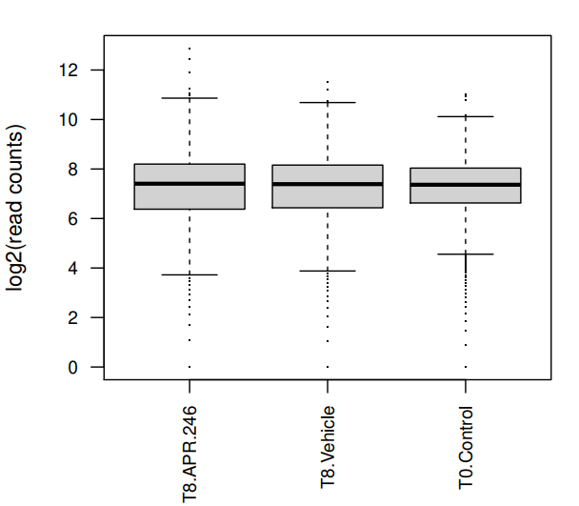
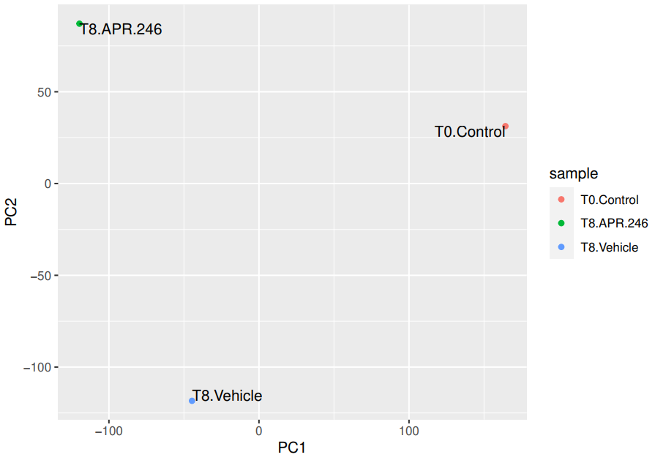
6. Counting sgRNAs - Outputs
Notes:
GiniIndex The Gini Index of the read count distribution. A smaller value indicates more eveness of the count distribution. (Recommended: around 0.1 for plasmid or initial state samples, and around 0.2-0.3 for negative selection samples) In the example data we expect only a few guides to be present as they are doing a negative selection screen. Gini index is a measure of inequality from economics. It is used in CRISPR analysis to assess if sgRNAs are present in equal amounts. In positive selection experiments, where only some sgRNAs dominate, the index can be high. However, as discussed in Li et al. 2015, in plasmid library, in early time points, or negative selection experiments, we expect fairly even distribution of the remaining sgRNAs that haven’t been negatively selected. A high Gini index in these types of sample can indicate CRISPR oligonucleotide synthesis unevenness, low viral transfection efficiency, and overselection, respectively.

Slide 50
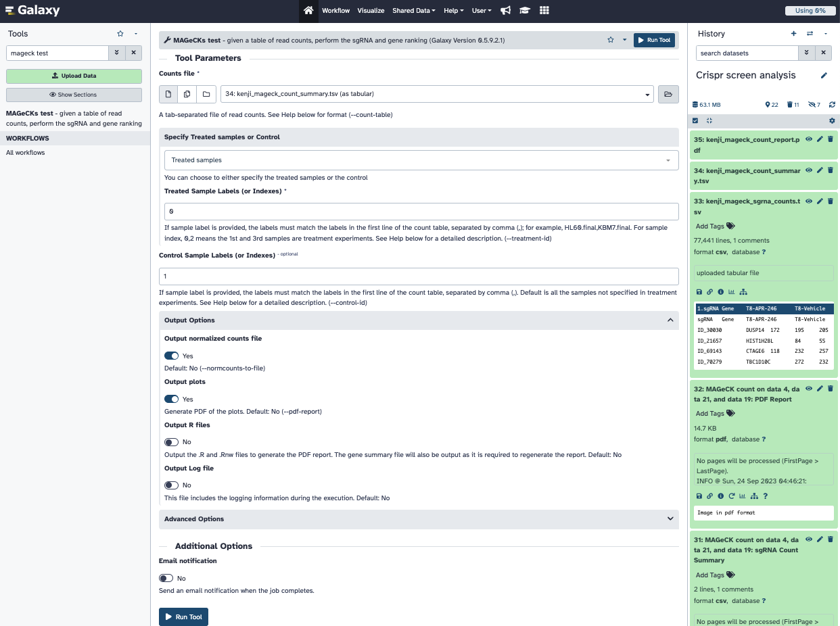
7. Identifying hits – MAGeCK test (RRA)
Notes:
This tests and ranks sgRNAs and genes based on the table provided.

Slide 51

7. Identifying hits – SgRNA ranking
Notes:
sgrna sgRNA ID
Gene The targeting gene
control_count Normalized read counts in control samples
treatment_count Normalized read counts in treatment samples
control_mean Mean read counts in control samples
treat_mean Mean read counts in treatment samples
LFC The log fold change of sgRNA
control_var The raw variance in control samples
adj_var The adjusted variance in control samples
score The score of this sgRNA
p.low p-value (lower tail)
p.high p-value (higher tail)
p.twosided p-value (two sided)
FDR false discovery rate
high_in_treatment Whether the abundance is higher in treatment samples

Slide 52

7. Identifying hits – Gene ranking
Notes:
##### Negative seclection screens #####
We are looking for guides that are depleted after the treatment. Becuase we are interested in drug sensitivity.
id Gene ID
num The number of targeting sgRNAs for each gene
neg|score The RRA lo value of this gene in negative selection
neg|p-value The raw p-value (using permutation) of this gene in negative selection
neg|fdr The false discovery rate of this gene in negative selection
neg|rank The ranking of this gene in negative selection
neg|goodsgrna The number of "good" sgRNAs, i.e., sgRNAs whose ranking is below the alpha cutoff (determined by the --gene-test-fdr-threshold option), in negative selection.
neg|lfc The log fold change of this gene in negative selection
pos|score The number of targeting sgRNAs for each gene in positive selection (usually the same as num.neg)
pos|score The RRA lo value of this gene in negative selection
pos|p-value The raw p-value of this gene in positive selection
pos|fdr The false discovery rate of this gene in positive selection
pos|rank The ranking of this gene in positive selection
pos|goodsgrna The number of "good" sgRNAs, i.e., sgRNAs whose ranking is below the alpha cutoff (determined by the --gene-test-fdr-threshold option), in positive selection.
pos|lfc The log fold change of this gene in positive selection

Slide 53


9. Interpreting results – Negative selection

Slide 54


9. Interpreting results – Negative selection
Notes:
How the abundance of the guides targeting FL1 gene is changing from vehicle to treatment. Here we are interested in guides that are dropping out that are increasing the cell sensitivity to the drug for this particular experiment. By looking at FL1’s plot, we wouldn't have enough confidence for this gene being one of the essential genes compared to some of the other guides as only one of its guide is depleted but the rest is not.

Slide 55


9. Interpreting results – Positive selection

Slide 56


9. Interpreting results – Positive selection
Notes:
mageck mle -k MV_4_11_counts.count.txt -d design_matrix_WT.txt --control-sgrna ../gp_files/control_guide_ids.txt --norm-method control --permutation-round 5 --cnv-norm cnv_data_mv411.txt -n MV_4_11_WT_MLE
mageck test -k -t 0 -c 1 -n output --normcounts-to-file --pdf-report

Slide 57

9. Pathway analysis

Slide 58

9. Pathway analysis

Slide 59



ACKNOWLEDGEMENTS
WEHI - Bioinformatics Division
Tony Papenfuss
Gordon Smyth
Saima Ikram
Kate Zhang
Luke Gandolfo
Terry Speed
Lizhong Chen
Papenfuss lab
WEHI Consumer Buddy Program
Katya Gray
Naveena Nekkalapudi
Keely Bumsted O'Brien
WEHI - Blood Cells and Blood Cancers Division
Dr Sarah Diepstraten
ONJ - Genome Engineering and Cancer Modelling
Marco Herold
Andrew Kueh
Christina Koenig
Emily Lelliott
Herold Laboratory
WEHI - Brain Cancer Centre
Jim Whittle
WEHI - Breast Cancer Division
Jane Visvader
Geoff Lindeman

Slide 60

Thank you all for attending this workshop!
https://github.com/goknurginer
https://twitter.com/goknurginer

